Slide 1
Network Model for IOT Needs

Slide 2
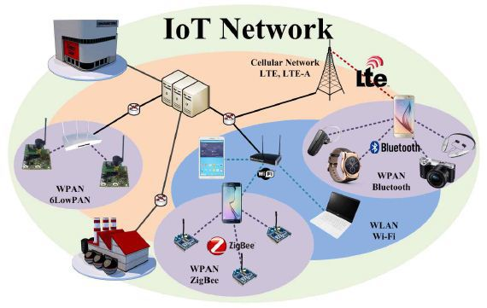
IoT Network Protocols
To understand IoT Networks let’s have a consider this picture.
WPAN (Wireless Personal Area Network) which include networks like ZigBee, Bluetooth, 6LowPAN etc.
On a slightly larger wireless network area scale, WLAN (Wireless Local Area Network) which includes Wi-Fi is to be used.
On a larger scale, LoRa and the mobile communication technologies like 2G, 3G,4G, LTE remains

Slide 3
Networks for Iot models

Slide 4
Wi-Fi
Wi-Fi is a WLAN (Wireless Local Area Network) technology based on the IEEE 802.11 standards.
Wi-Fi Devices :
Smartphones, Smart Devices, Laptop Computers, PC, etc.
Applications Areas :
Home, School, Computer Laboratory, Office Building, etc.
Wi-Fi devices and APs (Access Points) have a wireless communication range of about 30 meters indoors.
Wi-Fi data rate is based on its protocol type :
IEEE 802.11a can achieve up to 54 Mbps
IEEE 802.11b can achieve up to 11 Mbps
IEEE 802.11g can achieve up to 54 Mbps
IEEE 802.11n can achieve up to 150 Mbps
IEEE 802.11ac can achieve up to 866.7 Mbps
IEEE 802.11ad can achieve up to 7 Gbps

Slide 5
Bluetooth
Bluetooth is a WPAN (Wireless Personal Area Network) protocol designed by the Bluetooth SIG (Special Interest Group)
Replaces cables connecting many different types of devices
Mobile Phones & Headsets
Heart Monitors & Medical Equipment
Bluetooth’s standard PAN range is usually 10 meters (50 m in Bluetooth 4.0)
Bluetooth Low Energy (in Bluetooth 4.0) provides reduced power consumption and cost while maintaining a similar communication range.
Bluetooth 2.0 + EDR can achieve up to 2.1 Mbps
Bluetooth 3.0 + HS can achieve up to 24 Mbps
Bluetooth 4.0 can achieve up to 25 Mbps

Slide 6
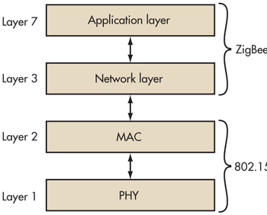
IEEE 802.15.4 Standard :
Low-cost, low-speed, low-power WPAN (Wireless Personal Area Network) protocol.
IEEE 802.15.4 applications
ZigBee, 6LoWPAN (IPv6 over Low power Wireless Personal Area Networks) etc.

Slide 7
ZigBee:
Supported by the ZigBee Alliance
Provides IEEE 802.15.4 higher layer protocols required for low powered radio system.
IEEE 802.15.4 defines the physical and MAC layers.
ZigBee provides the application and network layer protocols.
ZigBee works well in isolated network environments.
Zigbee network is made up of Coordinator (C) which is required to establish a network connection. ‘C’ establishes PAN, router (R) which provide the network connection to the end devices and End Device (E) which are the IoT devices connected to the network.

Slide 8
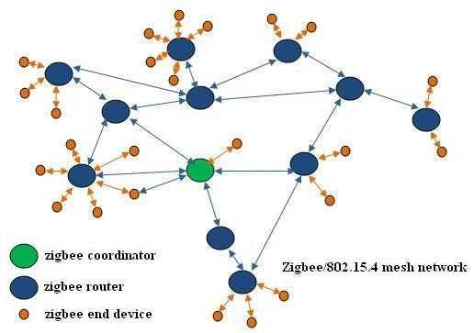
Zigbee Network

Slide 9
6LoWPAN (IPv6 over Low power Wireless Personal Area Networks) :
Supports IPv6 packets over IEEE 802.15.4 WPANs
Enables IPv6 IoT wireless network support
Low power design aspect included.
Good for battery operated IoT devices
6LoWPAN is an IETF (Internet Engineering Task Force) standard that uses the IEEE 802.15.4 WPAN technology.

Slide 10
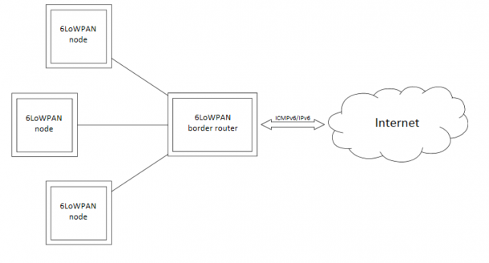
6lowPAN
In the 6LoWPAN node, Bluetooth Smart devices can connect to the internet over Bluetooth Smart using a border router. The border router acts as a device that is connected to the internet and provides access for the nodes to the internet.

Slide 11
LongRangeWAN
LoRaWAN is a standardized, bi-directional messaging protocol on top of LoRa modulation also known as the physical layer
In the data link layer, LoRaWAN manages channels, data rates and executes MAC commands
LoRaWAN messages contain device addresses and the server selects gateways for downlink in the network layer
The server and device keep track of frame counters and perform a message integrity check in the transport layer
LoRaWAN’s over the air activation (OTAA i.e. devices can go into sleep mode and using msg can come out of sleep mode) manages the creation of a new session with security context

Slide 12
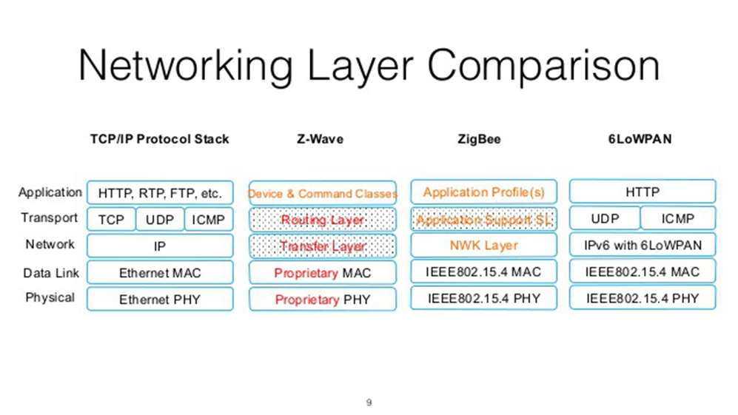

Slide 13
